Slide 1
BIBLICAL ANTHROPOLOGY IN EDUCATION Dana & Pavel Hanes
Theory and Practice

Slide 2
A Problem in Contemporary Education
I think there are two contradictory motives in contemporary education, both with monistic pretensions:
scientism – deterministic, under the influence of natural sciences (physics, chemistry, biology etc.)
subjectivism – indeterministic, under the influence of individualism and postmodernism (pluralism, freedom, self-esteem, etc.)
Christian theology teaches that human beings are both: a part of creation (eg. we are largely – not entirely – determined by nature) and: image of God (eg. we are largely – not entirely – free to choose our worldview)

Slide 3
What Is Biblical Anthropology?
“[Theological Anthropology] …includes the description of man, in his original condition before the fall, in his fall, and as fallen. It begins with the creation of man, discusses his essential parts, his fall, and especially treats of the doctrines of Sin and Free Will. A great deal will depend upon a correct apprehension of the teaching of Scripture with reference to such topics as "man created in the image of God," "original and actual sin," "imputation of guilt," "the free and enslaved will," "the relation of the human will to the divine work of regeneration," and kindred topics.”
traditional distinction: [Juvenal:] “Mens sana in corpore sano”
→ implicit dualism(?) of body and soul (physical and mental abilities)

Slide 4
Values and Monism
Facts/Values dichotomy (Hume: “It is impossible to derive ‘ought’ from ‘is’.”)
philosophy of eg. Hume, G.E.Moore (“Values are independent from facts” – we create them)
opposed by eg. Quine, Putnam (“We cannot differentiate between facts and values” – facts and values are in the same category of thought)
Monism (in both cases) is trying to create values “from below” (Emotions; Empathy; Evolution; Social construction, etc.)
[f/v dichotomy]…must be resisted if applied ethics is to succeed in closing the gap between factual descriptions of situations and moral judgments (Routledge Encyclopedia)

Slide 5
An Example from Emotivism
[C.S.Lewis The Abolition of Man] “In their second chapter Gaius and Titius quote the well-known story of Coleridge at the waterfall. You remember that there were two tourists present: that one called it 'sublime' and the other 'pretty'; and that Coleridge mentally endorsed the first judgement and rejected the second with disgust. Gaius and Titius comment as follows: 'When the man said This is sublime., he appeared to be making a remark about the waterfall... Actually ... he was not making a remark about the waterfall, but a remark about his own feelings. What he was saying was really I have feelings associated in my mind with the word "Sublime", or shortly, I have sublime feelings' Here are a good many deep questions settled in a pretty summary fashion. But the authors are not yet finished. They add: 'This confusion is continually present in language as we use it. We appear to be saying something very important about something: and actually we are only saying something about our own feelings.”

Slide 6
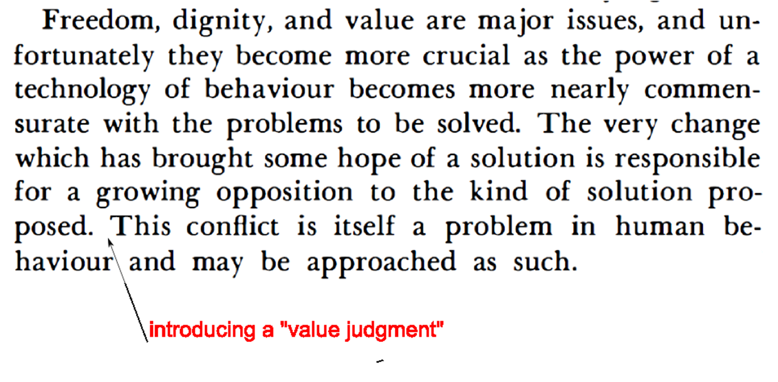
An Example from Determinism
B.F. Skinner Beyond Freedom and Dignity

Slide 7
Anomalous Monism: The Way Out?
[Stanford Encyclopedia] “Anomalous Monism is a theory about the scientific status of psychology, the physical status of mental events, and the relation between these issues developed by Donald Davidson. It claims that psychology cannot be a science like basic physics, in that it cannot in principle yield exceptionless laws for predicting or explaining human thoughts and actions (mental anomalism). It also holds that thoughts and actions must be physical (monism, or token-identity). Thus, according to Anomalous Monism, psychology cannot be reduced to physics, but must nonetheless share a physical ontology.”

Slide 8
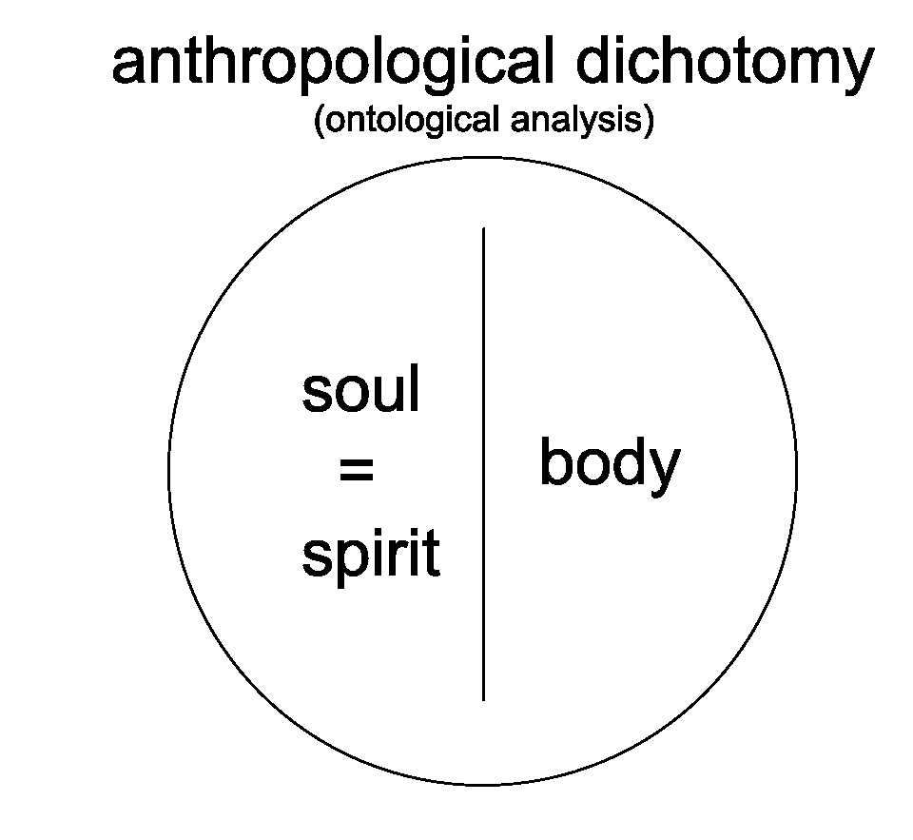
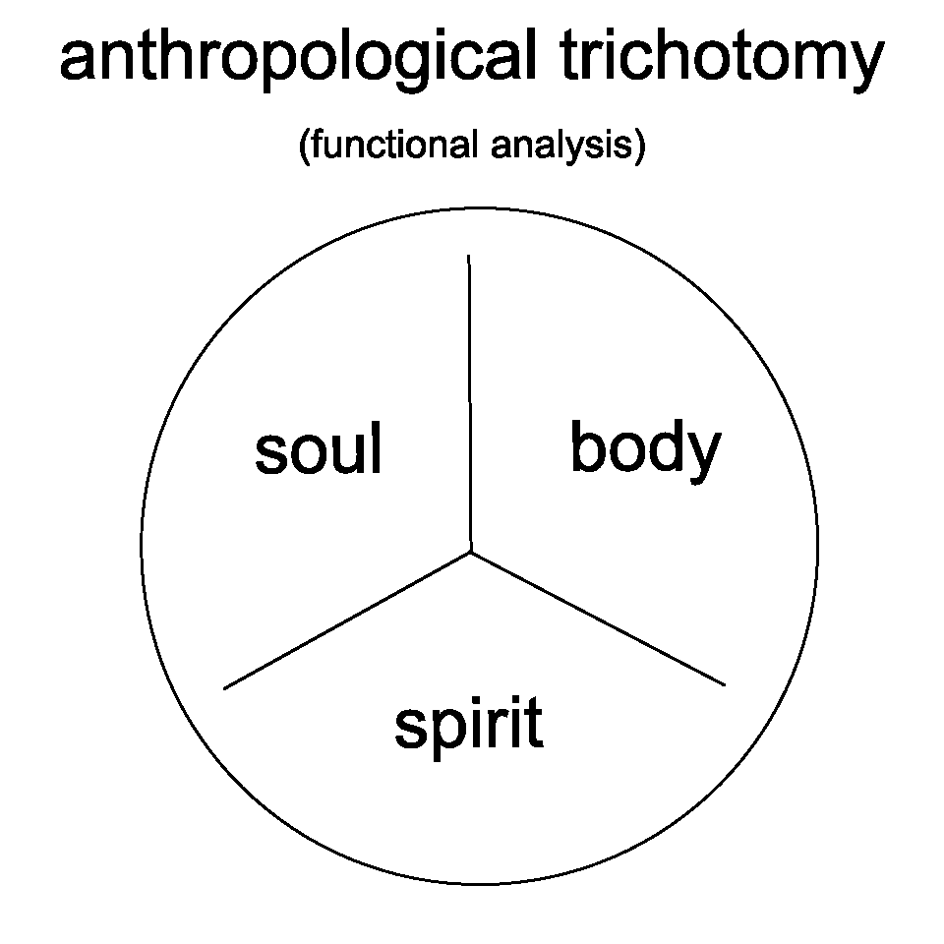
Biblical Dualism in Anthropology
The dangers of dividing – a human being is an essential unity (Genesis 2:7)!
simplified diagrams:

Slide 9
Understanding Values in Christianity
Traditional soul-spirit functional division:
human soul: mind, will, emotion
human spirit: intuition, conscience, worship
…are derived from the existence and character of God
God is spirit →
(John 4:24) [God is spirit,] and those who worship him must worship in spirit and truth.
(1Cor 2:14) The natural (ψυχικος!) person does not accept the things of the Spirit of God, for they are folly to him, and he is not able to understand them because they are spiritually discerned.

Slide 10
Teaching Values Using Biblical Anthropology
Values perceived by all humans:
(Rom 1:20) For his invisible attributes, namely, his eternal power and divine nature, have been clearly perceived, ever since the creation of the world, in the things that have been made.
Values that require Christian faith in Jesus’ death on the cross
(John 3:3) Truly, truly, I say to you, unless one is born again he cannot see the kingdom of God.

Slide 11
Theory in Practice
Values come “from above” (have ontological status – they are derived from God – his existence, character, will…)
The human spirit is eternal (highest value) – its interests should be our highest priority.
The human spirit can contact us with God (the source of all values) – we care about faith and the Word of God in education
The human spirit is a mystery – we need to pray to be able to access and address it (1Cor 2:11-16)
The human spirit is vulnerable – we have to be careful not to wound it. (A man's spirit will endure sickness, but a crushed spirit who can bear? Proverbs 18:14)

Slide 12
Thank You for Your Attention!

